Slide 1

Management of Newborn in Office
Jessie Marks DNP, ARNP

Slide 2
Learning objectives
Identify GI concerns in newborn infants
Understand common renal/urinary concerns in newborns and how to manage
Understand different umbilical complications and management of them
Know the difference between normal newborn movements vs seizures

Slide 3
Case Study
A first-time mother comes in with her 3-week-old son for concerns of vomiting. Mother states that he is vomiting large amounts and is constantly wanting to eat more. She is not sure what to do.
After obtaining more history you learn:
Infant vomits immediately after feeding
Vomit is forceful
Not green in color
No bloody stools or fever
Infant has only had 3 wet diapers in the last 24 hours
On exam you noticed a well-nourished infant who is slightly dehydrated (dry mucus membranes and lips), no tachycardia noted. Unsure but possible peristaltic waves seen while inspecting abdomen, no abdominal masses felt.
What is your diagnosis? Should you be concerned?

Slide 4
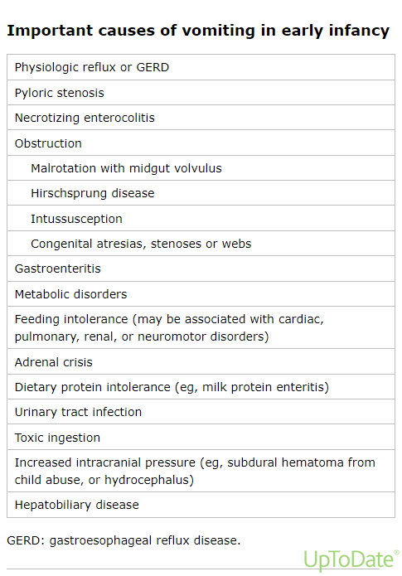

Slide 5
GI disorders in Neonates
Gastrointestinal Reflux (peaks 2 months to 6 months)
Infantile Hypertrophic Pyloric Stenosis (Peak 3 weeks to 6 weeks)
Necrotizing enterocolitis (birth to 2 weeks)
Food protein-induced allergic proctocolitis of infancy (peaks at a few months, can start as early as 1 week)

Slide 6
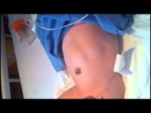
Infantile Hypertrophic Pyloric Stenosis
2-3.5 per 1,000 live births
More common in males and preterm infants
Presents around 3-6 weeks
30-40% of cases in first born children
Strong association of family history
Erythromycin and azithromycin are associated with increased risk (given < 2 weeks of age)
Caused by hypertrophy of the pylorus
Signs and symptoms
Immediate nonbilious postprandial vomiting ("projectile" vomiting)
Infant demands to be re-fed ("hungry vomiter")
Possible "olive-like mass"
Peristaltic waves
Most infants are diagnosed earlier, appear more well-nourished, if diagnosed later a may look emaciated and dehydrated
Management:
Ultrasound to confirm diagnosis
Surgical consult

Slide 7
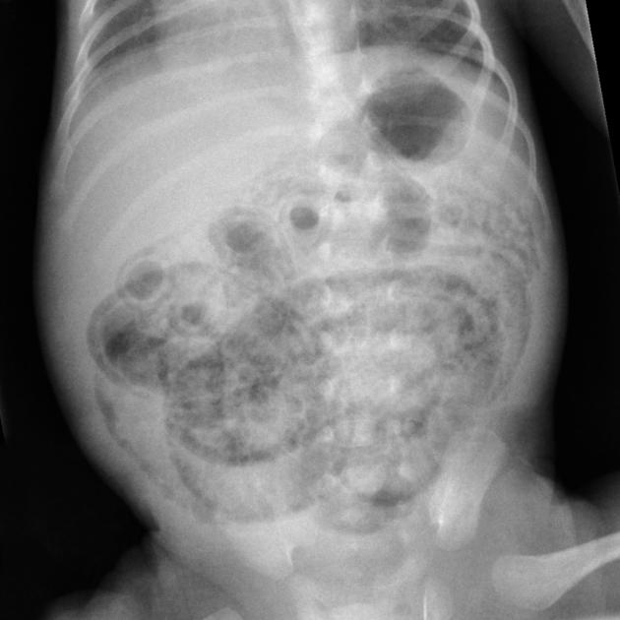

Necrotizing enterocolitis
This is a GI EMERGENCY
Risk Factors
Prematurity
Prolonged ROM with amnionitis
Birth asphyxia
SGA infants
Congenital heart disease
Exchange transfusions
Clinical Presentation
Poor feeding, Abdominal distention
Bilious emesis, Bloody stool
Respiratory distress
Sepsis (lethargy, temperature instability, apneic spells)
Diagnosis made by detecting blood in stool and abdominal x-ray
On x-ray will see dilated bowel loops, loss of normal gas shape, bowel wall edema, pneumoperitoneum (air outside the bowel)
Transfer to NICU for immediate support
Notes:
In NICU get TPN, stop feeds. IV abx

Slide 8
Food Protein-Induced Allergic Proctocolitis
Presents a few months after birth but can start as early as first week
Non IgE mediated reaction to food (milk, egg, soy, corn or a mix)
Presenting Symptoms:
Frequent visible blood in normal or loose stools
Loose stools with mucus, with or without gross or occult blood
Constipation, usually with occult blood (uncommon presentation)
Most often infants are well appearing despite GI symptoms.
Warning signs that suggest another diagnosis: unwell appearance, fever, poor weight gain, faltering growth, severe diarrhea, forceful vomiting and/or abdominal distention.
This is different than FPIES (food protein-induced enterocolitis syndrome) where symptoms are more severe and present a few hours after eating. Symptoms are (vomiting causing dehydration, abdominal distension, hypothermia, watery diarrhea)

Slide 9
Gastroesophageal Reflux (GER)
Uncomplicated GER – gastric contents reflux into esophagus
May need to rule out other conditions such as eosinophilic esophagitis, cow milk allergy and functional GI disease as well as trials of acid suppression

Slide 10
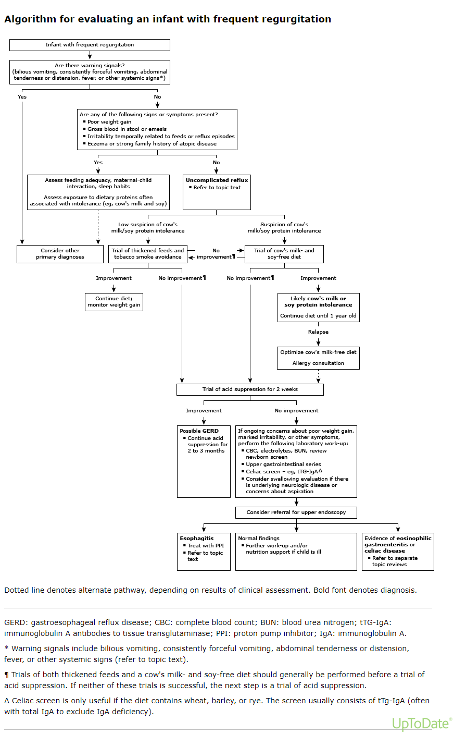

Slide 11
Case Study
A father of a 17-day old infant comes to the office with umbilical concerns. Father states that it looks different and not sure if its infected. He first noticed it a few days ago.
In your office infant is afebrile without signs of sepsis. On exam you note a small mass at the end of the umbilicus that is pink and friable. No discharge noted from umbilicus.
What is your assessment?
Are you concerned?

Slide 12
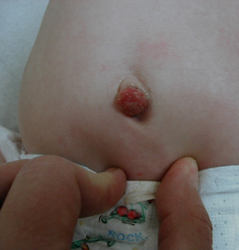
Umbilical cord
Delayed Separation
Umbilical cord falls off after 3 weeks
Umbilical granuloma
Most common cause of umbilical mass
Soft, moist, pink, friable lesion that is granulation tissue
Treatment: 75% topical silver nitrate, 1-2 times a week for a few weeks
If no response to silver nitrate, ligation can be done
No improvement with either treatment, suspicious for umbilical polyp
Umbilical polyp
Less common
Larger than granulomas
Consist of intestinal epithelium or uroepithelium
Require surgery

Slide 13
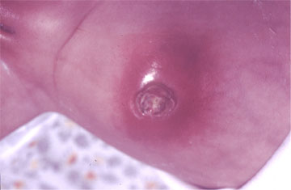
Omphalitis
Risk factors
Low birth weight
Prolonged labor and/or ROM
Maternal infection
Nonsterile delivery
Improper cord care (cultural application of cow dung)
Signs and symptoms
Purulent discharge from the umbilical cord stump with surrounding induration, erythema, and tenderness
In severe disease, infant may have lethargy, fever, irritability or poor feeding
Management:
Culture of discharge and IV antibiotics

Slide 14
Urinary Tract Dilation
Is the dilation of the renal pelvis (formally known as hydronephrosis)
Up to 70% are transient/physiologic etiology
Can be associated with UPJ obstruction, vesicoureteral reflux, or multicystic dysplastic kidney
Most often identified during prenatal ultrasound
Physical exam findings that could indicate congenital abnormality
Abdominal mass (could be from enlarged kidney)
Prune-belly syndrome or Eagle- Barrett syndrome (partial or complete absence of abdominal muscles, bilateral cryptorchidism, urinary tract malformations)
Out ear anomalies (increased risk of kidney anomalies)
Palpable bladder after voiding (may be from posterior urethral valves)
Single umbilical artery
Spinal or lower extremity abnormalities

Slide 15


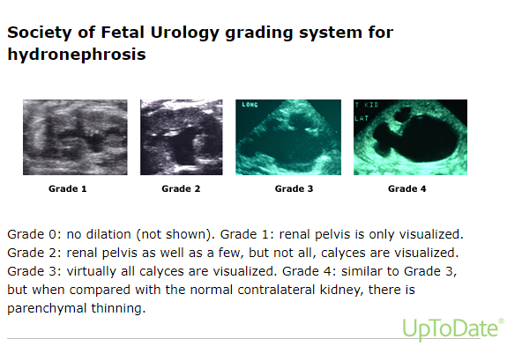

Management
Dependent upon the presence of bilateral involvement and severity of dilation
<10 mm – Normal or mild hydronephrosis. SFU grade 1
10 to 15 mm – Moderate hydronephrosis. SFU Grade 2
>15 mm – Severe hydronephrosis; these infants are at the greatest risk for significant renal disease, which may require surgical correction. SFU grade 3 and 4

Slide 16
Management
Ultrasonography is the preferred initial postnatal imaging study.
For bilateral fetal UTD or hydronephrotic solitary kidney, US is within 48 hours from birth
Unilateral fetal UTD with RPD > 10 mm in 3rd trimester, US should be performed after the infant returns to birth weight (2-4 weeks of life)
Persistent Moderate to severe UTD (RPD>15 mm) - VCUG is performed.
If no reflux but severe UTD then diuretic renography in consultation with urology
If reflux- observation, antibiotic prophylaxis or surgical correction depending on severity
Moderate UTD (RPD 10-<15mm)- repeat ultrasound in 4-6 months
Mild UTD – if no other genitourinary abnormalities noted on exam, no further eval

Slide 17
Antibiotic Prophylaxis
Is controversial
Some centers will treat moderate UTD (RPD 10-<15mm), while others will not treat
Most prophylactic treatment is reserved for dilated ureters (ectopic or refluxing), enlarged bladder, bilateral UPJ obstruction and severe UTD
Amoxicillin 20-40 mg/kg once daily is used
If PCN allergy: cephalexin is used

Slide 18
Abnormal Movements

Slide 19
Neonatal Seizures
Present at 1-2 days of life up to the first week
Subtle Seizures- most common type
Ocular Movements: eyelid blinking or fluttering, eyes rolling up, eye opening, gaze fixation or nystagmus
Oral Movements: sucking, smacking, chewing, tongue protrusions
Progression movements: rowing, swimming, pedaling, bicycling, thrashing or struggling movements
Clonic seizures
Rhythmic jerks
Either localized or multifocal
Tonic Seizures
Sustained contraction of facial, limb or axial muscles
Focal, multifocal, symmetrical or asymmetrical
Myoclonic seizures
Rapid, single or arrhythmic repetitive jerks
Notes:
Duration is 10s to 1-2 min

Slide 20
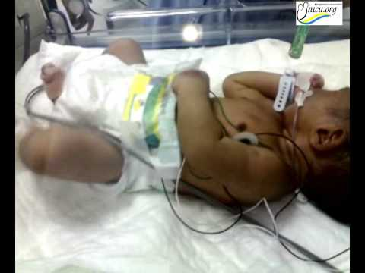
Focal Seizure
Notes:
https://www.youtube.com/watch?v=0j-pwZSKOpc

Slide 21
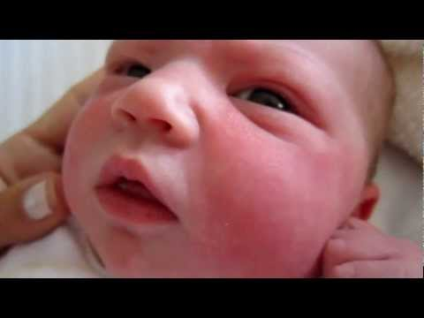
Subtle Seizure

Slide 22

Infantile Spasms
Peak is 4 months but can occur as early as 1 month
Presentation
- Sudden, rapid, tonic contraction of the trunk and limbs, sometimes for several seconds.
- flexion, extension or mixed
- occur in clusters
- typically occur after waking up or during sleep
Notes:
mean onset is 4 months, may occur as early as 1 month

Slide 23

Benign Neonatal Sleep Myoclonus
Onset- First day of life to about 3 weeks, resolves by 12 weeks
Presentation-
Myoclonic jerks
Synchronous or asynchronous
Unilateral or bilateral
Usually last 10-20 seconds
Seen mostly in distal part of upper extremities
Occurs during sleep
Movements stop when awake

Slide 24
References
https://www.merckmanuals.com/professional/pediatrics/gastrointestinal-disorders-in-neonates-and-infants/necrotizing-enterocolitis
Panayiotopoulos CP. The Epilepsies: Seizures, Syndromes and Management. Oxfordshire (UK): Bladon Medical Publishing; 2005. Chapter 5, Neonatal Seizures and Neonatal Syndromes. Available from: https://www.ncbi.nlm.nih.gov/books/NBK2599/
Infantile hypertrophic pyloric stenosis. Olive, A. P., Endom, E. E., Up To Date, Accessed February 9,2019.
Care of the umbilicus and management of umbilical disorders. Palazzi, D. L. and Brandt, M. L. Up To Date, Accessed February 9, 2019.
Postnatal management of fetal hydronephrosis. Baskin, L. S. Up To Date. Accessed February 10, 2019.
Winter, H. S. (n.d.). Gastroesophageal Reflux in Infants. Shibboleth authentication request. Retrieved April 26, 2022, from https://www-uptodate-com.offcampus.lib.washington.edu/contents/gastroesophageal-reflux-in-infants?search=pyloric+stenosis+infant&topicRef=5890&source=see_link

